Slide 1

IMAGE CLASSIFICATION PROJECT
Presented By:
NITISH KUMAR SHARMA

Slide 2
PROBLEM STATEMENT
Images are one of the major sources of data in the field of data science and AI. This field is making appropriate use of information that can be gathered through images by examining its features and details. We are trying to give you an exposure of how an end to end project is developed in this field.
The idea behind this project is to build a deep learning-based Image Classification model on images that will be scraped from e-commerce portal. This is done to make the model more and more robust

Slide 3
EDA STEPS
We will start by importing the libraries that we require for performing EDA. These include NumPy, Pandas for handling dataset and mathematic computation, Matplotlib for visualization, Tensorflow and keras for image classification.
We will now load the directories that we created during web scrapping of garments (i.e sarees, jeans and trousers).
We will display some sample images from train data directory of garments.
Then we will define dimensions for images and then fix the parameters like shape, width, height, batch size,etc.
Used Image Data Generator to generate data according to some pattern for images.

Slide 4
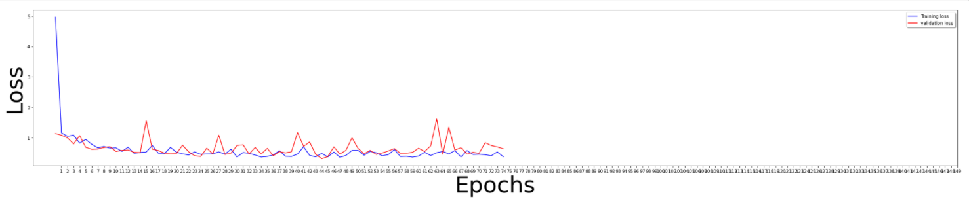
VISUALIZATIONS
Losses are decreasing as number of epochs are increasing.

Slide 5
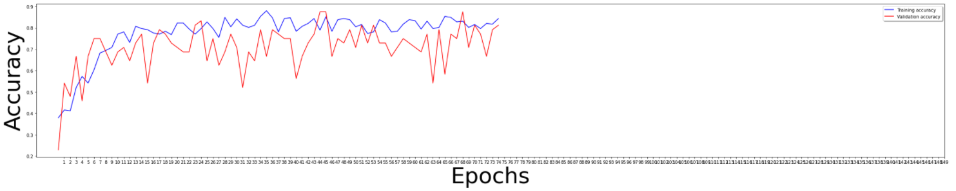
Accuracy is increasing as number of epochs are increasing.

Slide 6
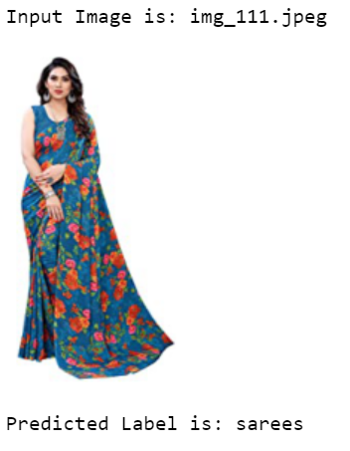
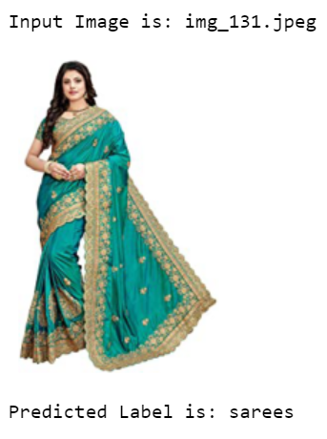
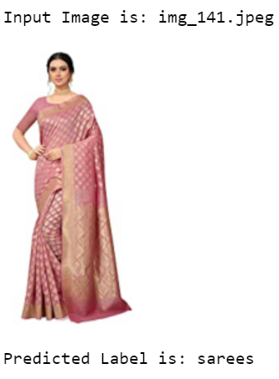
Here we can see the few loaded images of Sarees which we scrapped from e-commerce website (Amazon) and our classification model predicted the label exactly the same.

Slide 7
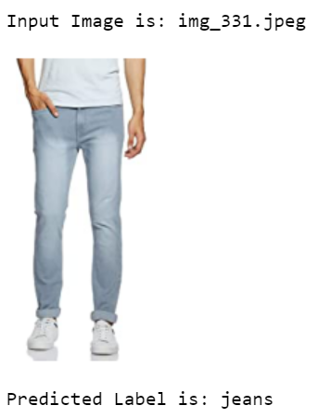
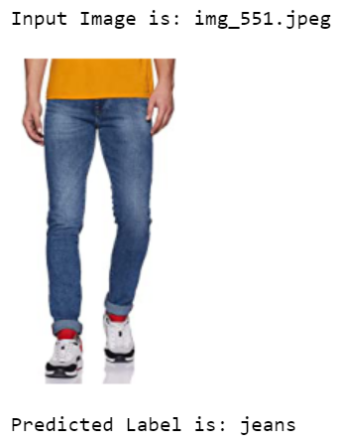
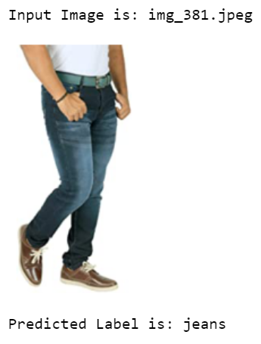
Here we can see the few loaded images of Jeans which we scrapped from e-commerce website (Amazon) and our classification model predicted the label exactly the same.

Slide 8
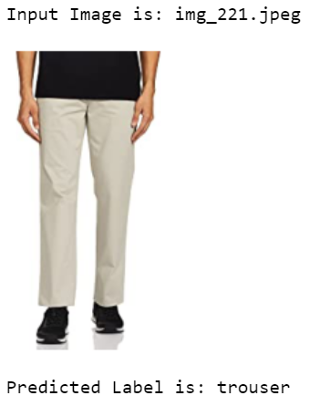
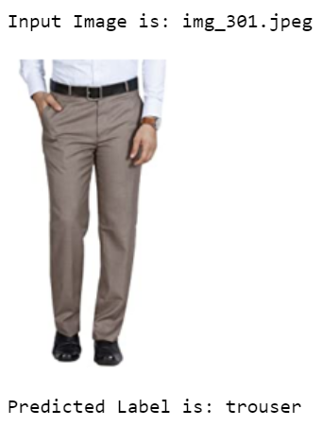
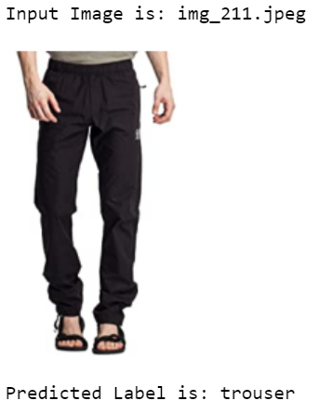
Here we can see the few loaded images of Trousers which we scrapped from e-commerce website (Amazon) and our classification model predicted the label exactly the same.

Slide 9
STEPS & ASSUMPTIONS TAKEN
Installed tensorflow and keras for solving deep learning problem of Image classification.
Using steps_per_epoch to define how many batches of samples to use in one epoch.
Used validation_steps to start the evaluation from the beginning of the dataset at each epoch.
Build a convolutional neural network (CNN) model to classify/predict images for correct labels.
Defined Early stopping by setting mode to min to stop training when the quantity monitored has stopped decreasing and Model check point mode to max to achieve maximum validation accuracy.
Assigning binary values to Jeans as 0, Sarees as 1 and Trousers as 2 to display the result in a proper dataframe.

Slide 10
CONCLUSION
The Convolutional Neural Network (CNN), a machine learning algorithm is being used for the image classification.
On epoch 75, we get the best accuracy of 87.50%.
The roles of epochs in DNN was able to control accuracy and also prevent any problems such as overfitting.
Images used in the training purpose are small.
The Deep neural network (DNN) becomes the main agenda for this research, especially in image classification technology.
Data format plays a very important role in the visualization.

Slide 11
THANK YOU!

